Slide 1

Development of Fire Protection Plan

Slide 2

Agenda
Introduction
Risk Assessment
Fire Protection System and Equipment
Evacuation Plan
Fire Safety Training
Conclusion

Slide 3
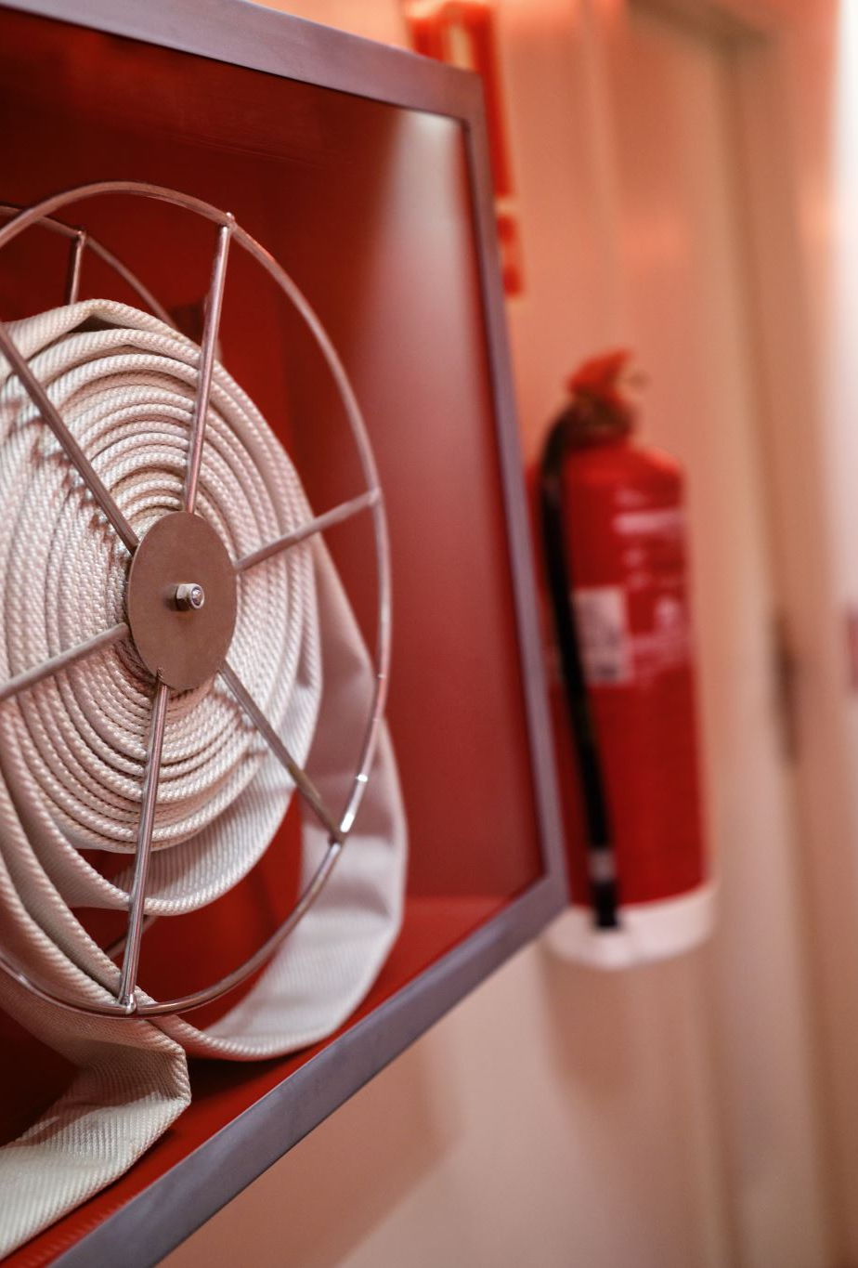
Introduction
Fire Protection Plan is necessary
Helps to minimize risk of fire
Decrease potential impact on people, property, and environment
Identifying fire hazards
Evaluate likelihood and consequences of fire occurring
Implementing fire detection and alarm system
Fire fighting equipment and evacuation plans

Slide 4
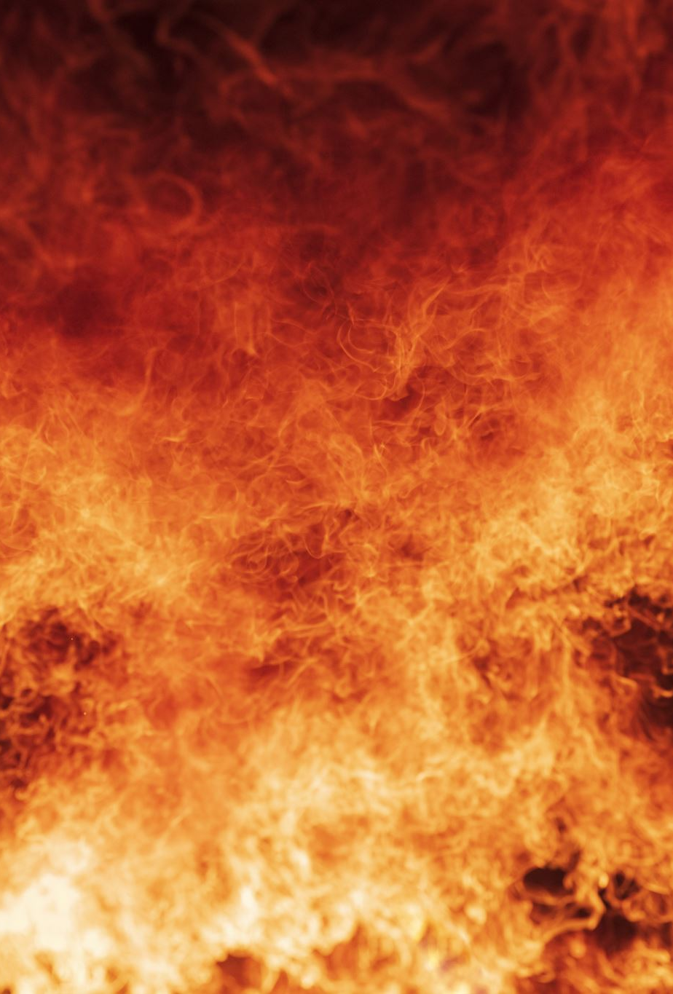
Risk Assessment
Identifying fire hazards: This involves identifying potential sources of ignition and fuel for a fire to start and spread
Assessing the risk: This involves evaluating the likelihood of a fire occurring and the potential consequences if it does
Implementing fire protection measures: installing fire alarms, fire suppression systems, and fire-resistant construction materials

Slide 5
Fire Protection System and Equipment
Fire Alarms: Fire alarms are designed to detect smoke or heat and activate an audible alarm to alert building occupants of a fire
Fire Suppression Systems: Fire suppression systems, such as sprinklers and fire suppression foam systems, are designed to automatically extinguish fires by releasing fire-extinguishing agents
Fire Extinguishers: Portable fire extinguishers are designed to be used by building occupants to quickly put out small fires
Fire Escape Routes: Fire escape routes are designated paths for building occupants to safely evacuate the building in case of a fire

Slide 6
Fire Safety Training
Goal is to educate building occupants on how to prevent fires, respond to fires, and evacuate the building safely
Fire prevention: This includes training on how to identify and eliminate fire hazards, as well as proper storage of flammable materials
Fire response: This includes training on how to evacuate the building safely, use fire extinguishers, and call emergency services
Evacuation procedures: This includes training on how to evacuate the building using designated fire escape routes and how to respond to fire alarms.
Fire drills

Slide 7


